Slide 1




Air Quality Monitoring
Discover the importance of monitoring air quality, including key pollutants and their health effects.
by Mani Mani Dev

Slide 2
Methods of Air Quality Monitoring
1
Monitoring Stations & Equipment
Explore the infrastructure and tools used for air quality monitoring, from stationary stations to portable devices.
Continuous vs. Passive Methods
2
Dive into the differences between continuous monitoring, which provides real-time data, and passive monitoring, which captures average levels over a period.
3
Remote Sensing & Satellite Data
Discover how remote sensing and satellite data enhance our understanding of air quality on a larger scale.

Slide 3

Interpreting Air Quality Data
1
Air Quality Index (AQI)
2
Pollutant Thresholds & Implications
Learn about the AQI, a standardized scale that simplifies air quality information for better comprehension and decision-making.
Understand the significance of pollutant thresholds and their impact on human health and the environment.
3
Understanding Trends & Patterns
Uncover the analytical techniques used to interpret air quality data and identify patterns and trends over time.

Slide 4
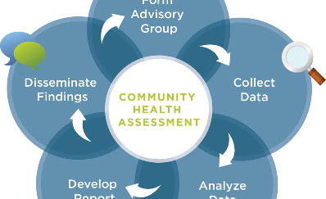
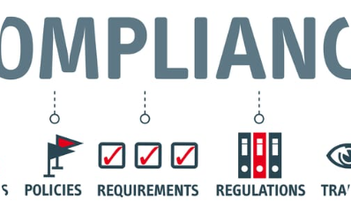
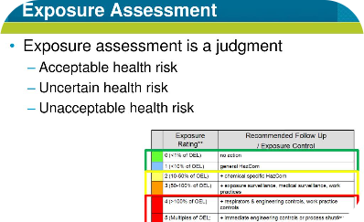
Applications of Air Quality Monitoring
Public Health & Environmental Impact Assessments
Regulatory Compliance & Policy Development
Personal Exposure Assessment
Explore the role of air quality monitoring in setting regulations and policies to protect public health and the environment.
Learn how individuals can monitor their personal exposure to air pollutants and make informed choices to improve their well-being.
Discover how air quality monitoring aids in assessing the potential health risks and environmental impacts of air pollution.

Slide 5
Challenges & Limitations of Air Quality Monitoring
1
Availability & Reliability of Data
Discuss the challenges associated with collecting and ensuring the accuracy and reliability of air quality data.
2
Spatial & Temporal Variability
Understand how air pollution levels can vary across different locations and over different time periods.
3
Interpreting & Communicating Data Accurately
Highlight the importance of effectively interpreting and communicating air quality data to address public concerns and facilitate informed decision-making.

Slide 6
Future of Air Quality Monitoring
Advances in Monitoring Technologies
Integration of Air Quality Data with Other Systems
Role of Citizen Science & Public Engagement
Explore the latest innovations in air quality monitoring technologies, such as sensor networks and real-time data visualization.
Discover how air quality data is integrated with other systems, such as weather forecasting and urban planning, to improve decision-making and mitigate pollution.
Learn how citizen science initiatives and public engagement campaigns are contributing to air quality monitoring efforts and promoting awareness and action.

Slide 7

Conclusion and Key Takeaways
Summarize the key points discussed throughout the presentation and emphasize the significance of air quality monitoring for a healthier and more sustainable future.

